Slide 1


KGCN PROGRESS PRESENTATION Design of a graph-based, deep learning model to predict the optimal resolution for a Sonar Perfomance Model
26.06.2020
Author: Jakub Pietrak
Supervisor: dr Joris Sijs
MSc Systems & Control

Slide 2
Presentation Contents:
Research Question
Simulation Setup
Data Analysis
Grakn & KGCN Setup (11-14)
KGCN Intermediate Results (15-24)
Questions (25)
Github runtime instructions (26-30)
Problem Definition Background Info

Slide 3
Problem Introduction:
Research Question
“Design of a Graph Neural Network for the BELLHOP Sonar Performance Model, to predict the optimal simulation resolution, required to achieve a convergent solution of an acoustic field.”
Or in other words:
Is it possible to reconstruct the simulation model optimal resolution parameter (found in an iterative, time-consuming way), with use of GNN processing the same set of input features?

Slide 4
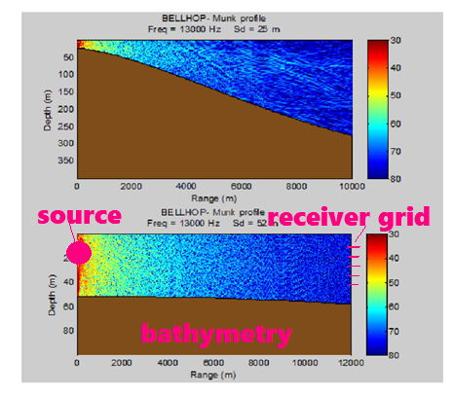
2. Simulation Setup
Model Variables
Transmission Loss
Acoustic model (GBT): BELLHOP
RESOLUTION:
Number of rays
(emitted from the source, mapping the medium)
Scenario INPUTS:
source frequency 1000Hz (const.)
source depth
water depth min
water depth max
slope [-2, 0, +2] deg
length of a column 44km (const.)
bottom type coefficients
sound speed profile (SSP)
OUTPUT:
Transmission Loss in the medium, convergence calculated at the receiver grid
Source: DOI:10.1109/IBCAST.2017.7868122

Slide 5
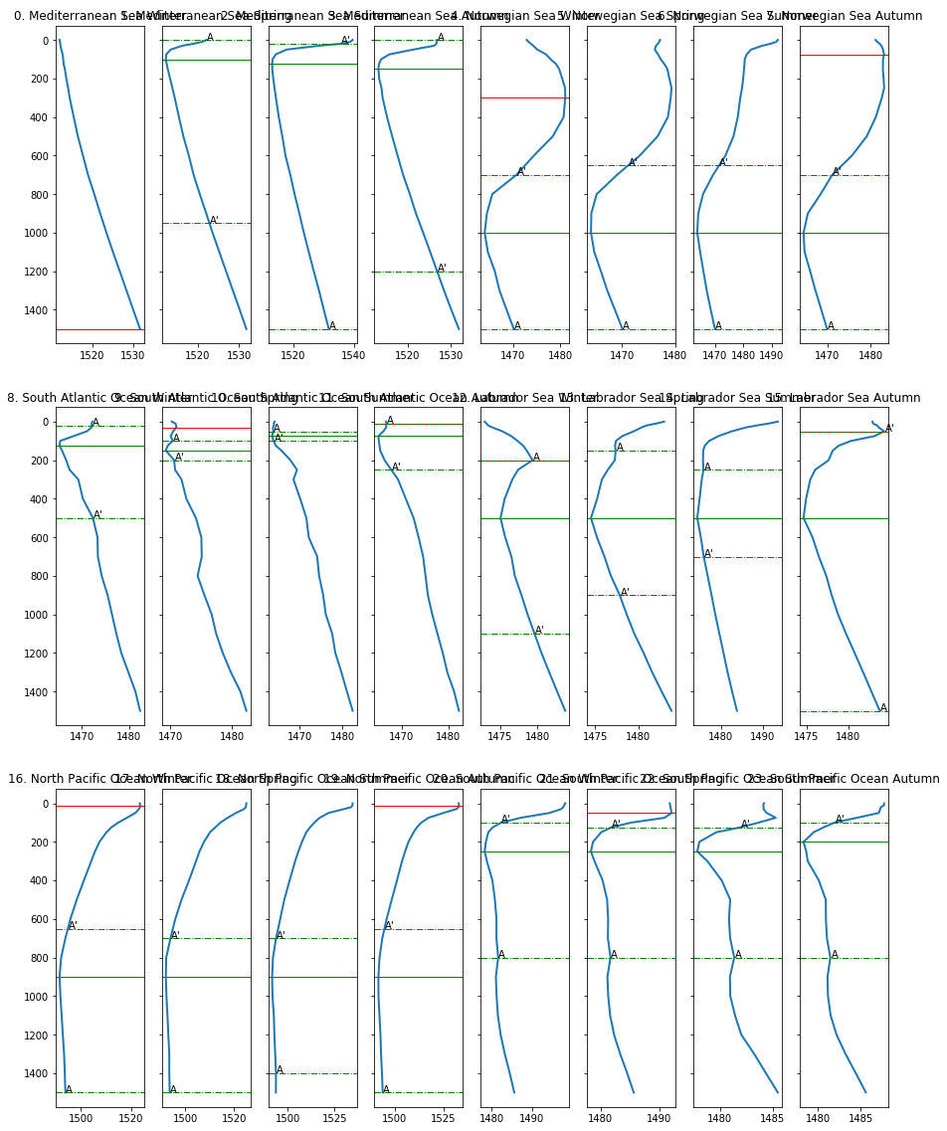
2. Simulation Setup ctd.
II. Sound Speed Profiles
6 locations × 4 seasons = 24 unique SSPs
Each SSP input is a (discretized) function c(z)
c = sound speed
z = depth
Green and red lines represent some additional characteristics that are taken into account in the feature vector for GNN model (sound propagation ducts).

Slide 6

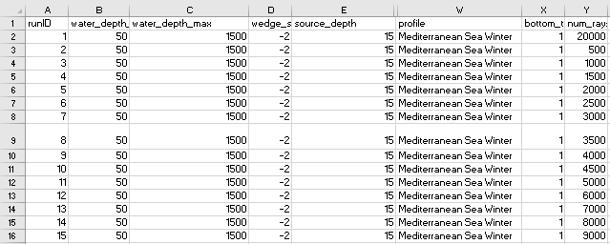
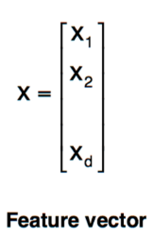
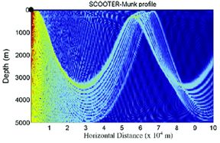
2. Simulation Setup ctd.
Feature vector representation:
different data formats
38x1 vector
convergence reached at: 5000 rays
BELLHOP
DATASET SIZE:
~9000 samples
sample = scenario S(i) with unique set of features

Slide 7
2. Simulation Setup ctd.
III. Simulation Meta-Algorithm
for S(i):
calculate TL’(u’) with u’ = 20000 rays
for u = {500, 1000, …, 10k, 12.5k, 15k}:
calculate TL(u)
delta TL = TL’(u’) – TL(u)
if delta < 1dB:
scenario converged
S -> S(i+1)
break
else:
u -> u(j +1)
baseline 20k run is assumed
to be completely accurate
unequal intervals in [500,15000]
grid size 17
u – num_rays
S – a unique set of scenario parameters
TL – transmission loss

Slide 8
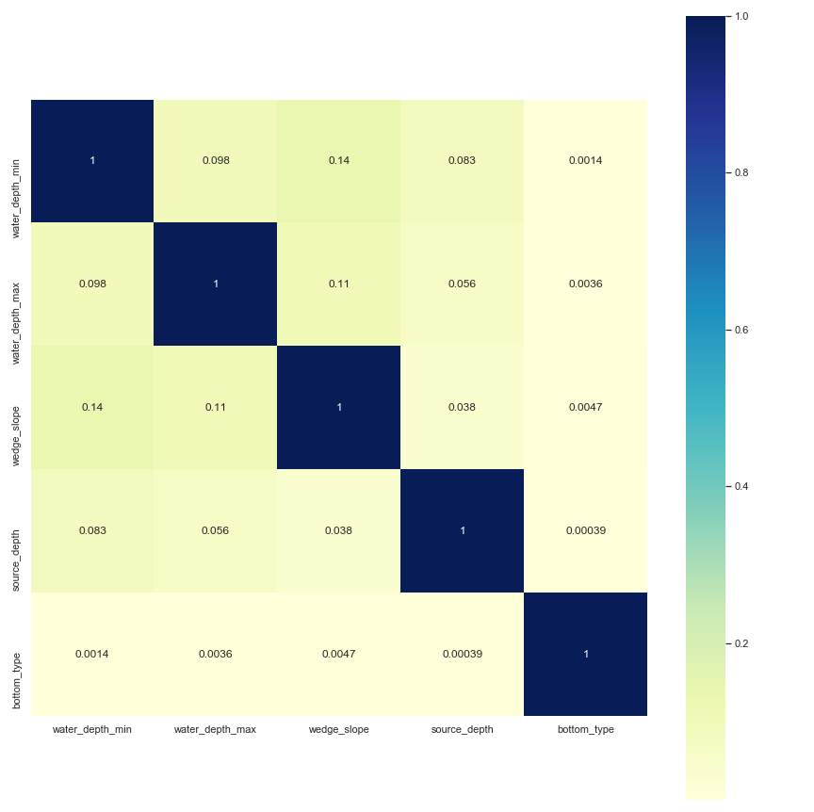
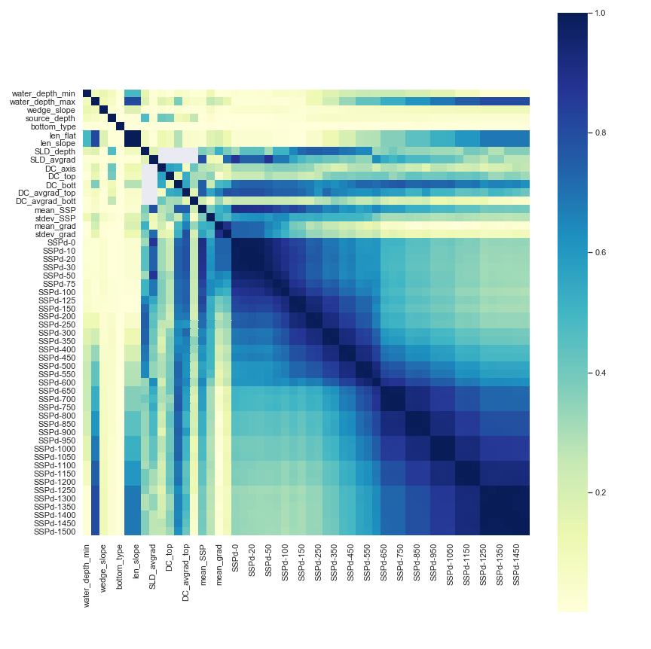
3. Data analysis
Data correlation:
- Model features are uncorrelated
- SSP-vec entries are highly correlated with each other

Slide 9
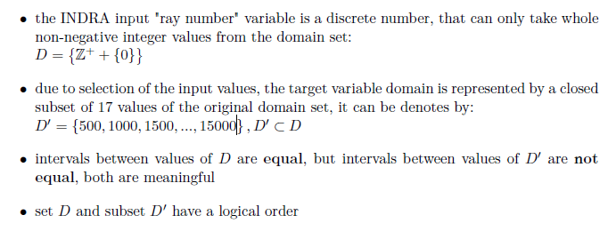
3. Data analysis
Target variable = resolution = num_rays
num_rays = {500, 1000, 1500, 2000, 2500, 3000, 3500, 4000, 4500, 5000, 6000, 7000, 8000, 9000, 10000, 12500, 15000}
Discrete variable, non equal intervals
=> Classification problem with 17 classes

Slide 10
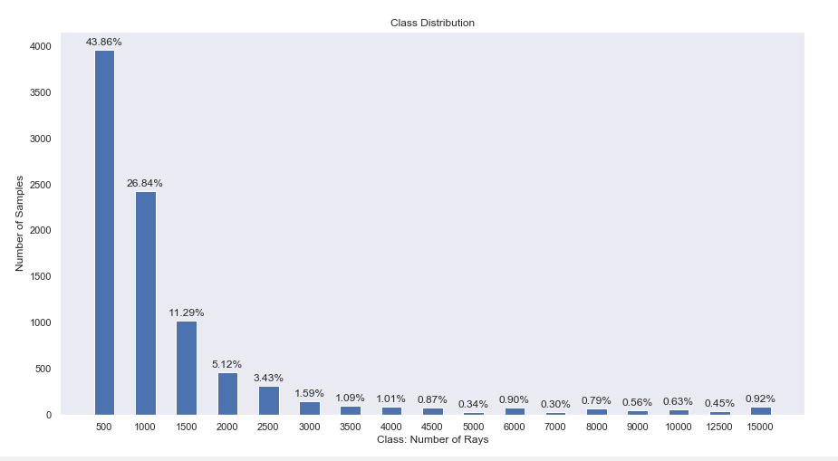
3. Data analysis
Target variable distribution
CLASS IMBALANCE PROBLEM

Slide 11
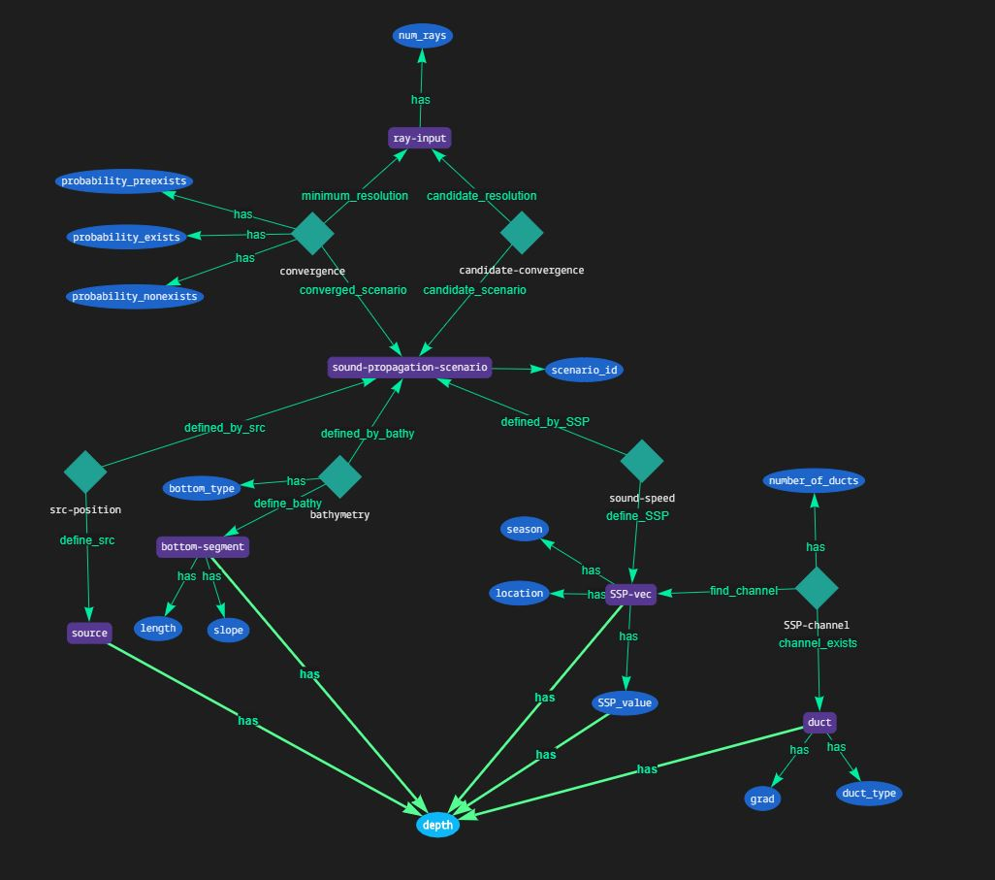
4. Grakn & KGCN Setup
Schema
shared depth attribute
candidate-convergence by grakn rule
varying graph representations!
bottom-seg can appear 1 or 3 Times
SSP-channel can appear 0,1,2 times
variable number of SSP_value based on depths appearing in the graph =>
SSP_value has depth
ssp_schema_kgcn.gql
[…]
sound-propagation-scenario sub entity, key scenario_id
ray-input sub entity, key num_rays

Slide 12
4. Grakn & KGCN Setup:
II. Query – the same for all scenarios*
*there’s a workaround reduced query for scn without ducts, but that’s not really important
convergence_query_full = inspect.cleandoc(
f'''match
$scn isa sound-propagation-scenario, has scenario_id {scenario_idx};’ '''$ray isa ray-input, has num_rays $nray; $src isa source, has depth $dsrc;
$seg isa bottom-segment, has depth $dseg, has length $l, has slope $s;
$conv(converged_scenario: $scn, minimum_resolution: $ray) isa convergence;
$srcp(defined_by_src: $scn, define_src: $src) isa src-position;
$bathy(defined_by_bathy: $scn, define_bathy: $seg) isa bathymetry, has bottom_type $bt;
$ssp isa SSP-vec, has location $loc, has season $ses, has SSP_value $sspval, has depth $dsspmax;
$dct isa duct, has depth $ddct, has grad $gd;
$speed(defined_by_SSP: $scn, define_SSP: $ssp) isa sound-speed;
$duct(find_channel: $ssp, channel_exists: $dct) isa SSP-channel, has number_of_ducts $nod;
$sspval has depth $dssp;
{$dssp == $dsrc;} or {$dssp == $dseg;} or {$dssp == $ddct;} or {$dssp == $dsspmax;};
get;'''
)
candidate_convergence_query = inspect.cleandoc(f'''match
$scn isa sound-propagation-scenario, has scenario_id {scenario_idx};'''
'''$ray isa ray-input, has num_rays $nray;
{$nray == 500;} or {$nray == 1000;};
$conv(candidate_scenario: $scn, candidate_resolution: $ray) isa candidate-convergence;
get;''')

Slide 13
4. Grakn & KGCN Setup:
using modified learn, pipeline and loss, similar to vehicle TNO example to allow for saving & reloading nx. graphs and tf. models
train-test and validation division, validation on unseen data (not tested yet)
working on reduced, stratified, shuffled and balanced datasets

Slide 14
5. KGCN Intermediate Results:
In result, graphs for each scenario can grow quite large:
approx. 25-45 variables in the graph, depending on scenario complexity
16 x 3 = 48
(candidate-convergence, ray-input, ray_nr) tuples while working on a full set of target classes

Slide 15
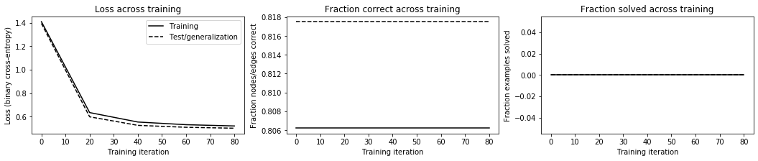
5. KGCN Intermediate Results:
Results with 17 classes – 30 samples in each class:
0 graphs solved correctly in training and generalisation
ALL RELATIONS ARE PREDICTED TO NOT EXIST
# (iteration number), T (elapsed seconds), Ltr (training loss), Lge (test/generalization loss), Ctr (training fraction nodes/edges labeled correctly), Str (training fraction examples solved correctly), Cge (test/generalization fraction nodes/edges labeled correctly), Sge (test/generalization fraction examples solved correctly) # 00000, T 4.8, Ltr 1.3607, Lge 1.3883, Ctr 0.8087, Str 0.0000, Cge 0.8193, Sge 0.0000 # 00020, T 12.4, Ltr 0.6541, Lge 0.6391, Ctr 0.8087, Str 0.0000, Cge 0.8193, Sge 0.0000 # 00040, T 16.6, Ltr 0.5485, Lge 0.5307, Ctr 0.8087, Str 0.0000, Cge 0.8193, Sge 0.0000 # 00060, T 20.8, Ltr 0.5234, Lge 0.5052, Ctr 0.8087, Str 0.0000, Cge 0.8193, Sge 0.0000 # 00080, T 25.0, Ltr 0.5143, Lge 0.4963, Ctr 0.8087, Str 0.0000, Cge 0.8193, Sge 0.0000

Slide 16
5. KGCN Intermediate Results:
Results with 17 classes – 30 samples in each class:
0 graphs solved correctly in training and generalisation
My interpretation:
loss drops due to correctly identified non-existing 16 classes
but the learner does not learn how to predict the existing class at all
Loss Function modification?
Not enough data? Training not long enough?
>>>> PROBLEM TOO COMPLEX TO ANALYSE
Next step: Simplify the problem.
Try with limited amount of classes

Slide 17
Disclaimer:
Testing with limited classes usually requires new data migration, because of candidate-convergence relations.
Entity & attribute pair (ray-input, num_rays) is being inserted based on np.unique(data[‘num_rays’]), which means that the number of pairs is dictated by target var. range in data.
Candidate-convergence connects every ray-input with a scenario, where there’s no convergence, so it creates N-1 connections (N = number of classes).
I’ve realized it’s faster to do it like that, than to insert ‘OR’ statement into the query for candidate convergence.

Slide 18
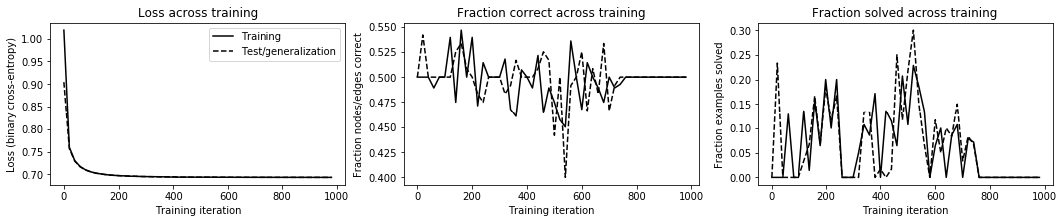
5. KGCN Intermediate Results:
Results with 2 classes [500, 1000] rays, 100 samples per class, training split 70/30, 10 processing_steps:
still inconsistent results: loss decreases but graphs are solved incorrectly
loss converges at high value 0.7
unstable behaviour
final probability exactly at 50% for each generalisation (test) graph

Slide 19
5. KGCN Intermediate Results:
Results with 2 classes:
# 00000, T 7.1, Ltr 1.0187, Lge 0.9046, Ctr 0.5000, Str 0.0000, Cge 0.5000, Sge 0.0000
# 00020, T 20.5, Ltr 0.7593, Lge 0.7564, Ctr 0.5000, Str 0.0000, Cge 0.5417, Sge 0.2333
# 00040, T 29.4, Ltr 0.7298, Lge 0.7289, Ctr 0.5000, Str 0.0000, Cge 0.5000, Sge 0.0000
…
# 00140, T 73.8, Ltr 0.7005, Lge 0.7004, Ctr 0.4750, Str 0.0143, Cge 0.5250, Sge 0.0667
# 00160, T 82.6, Ltr 0.6990, Lge 0.6988, Ctr 0.5464, Str 0.1571, Cge 0.5333, Sge 0.1667
# 00180, T 91.5, Ltr 0.6979, Lge 0.6979, Ctr 0.5000, Str 0.0643, Cge 0.5083, Sge 0.0667
# 00200, T 100.4, Ltr 0.6972, Lge 0.6972, Ctr 0.5393, Str 0.2000, Cge 0.5000, Sge 0.1833
# 00220, T 109.2, Ltr 0.6967, Lge 0.6966, Ctr 0.4714, Str 0.1000, Cge 0.4833, Sge 0.1167
# 00240, T 119.2, Ltr 0.6960, Lge 0.6962, Ctr 0.5143, Str 0.2000, Cge 0.4750, Sge 0.1667
….
# 00460, T 235.3, Ltr 0.6940, Lge 0.6938, Ctr 0.4643, Str 0.0643, Cge 0.5250, Sge 0.2500
# 00480, T 247.8, Ltr 0.6939, Lge 0.6938, Ctr 0.4893, Str 0.2071, Cge 0.5167, Sge 0.1167
# 00500, T 259.2, Ltr 0.6939, Lge 0.6938, Ctr 0.4750, Str 0.1071, Cge 0.4417, Sge 0.2167
# 00520, T 269.1, Ltr 0.6939, Lge 0.6938, Ctr 0.4571, Str 0.2286, Cge 0.5000, Sge 0.3000
…
# 00660, T 335.9, Ltr 0.6936, Lge 0.6935, Ctr 0.4893, Str 0.0857, Cge 0.4833, Sge 0.0833
# 00680, T 347.9, Ltr 0.6935, Lge 0.6935, Ctr 0.4750, Str 0.1071, Cge 0.5333, Sge 0.1500
# 00700, T 360.1, Ltr 0.6935, Lge 0.6935, Ctr 0.5000, Str 0.0000, Cge 0.4667, Sge 0.0333
# 00720, T 371.0, Ltr 0.6935, Lge 0.6935, Ctr 0.4893, Str 0.0786, Cge 0.4917, Sge 0.0833
…
# 00980, T 499.5, Ltr 0.6933, Lge 0.6933, Ctr 0.5000, Str 0.0000, Cge 0.5000, Sge 0.0000

Slide 20
5. KGCN Intermediate Results:
Results with 2 classes [500, 1000] rays, 100 samples per class, training split 70/30, 10 processing_steps:
Queries to be inserted back to Grakn – 50\50 exists and non-exists probability
match $scn id V176240; $ray id V2306192; insert $conv(converged_scenario: $scn, minimum_resolution: $ray) isa convergence, has probability_exists 0.500, has probability_nonexists 0.500, has probability_preexists 0.000;
match $scn id V176240; $ray id V42041560; insert $conv(converged_scenario: $scn, minimum_resolution: $ray) isa convergence, has probability_exists 0.500, has probability_nonexists 0.500, has probability_preexists 0.000;
match $scn id V32880; $ray id V42041560; insert $conv(converged_scenario: $scn, minimum_resolution: $ray) isa convergence, has probability_exists 0.500, has probability_nonexists 0.500, has probability_preexists 0.000;

Slide 21
5. KGCN Intermediate Results:
Results with 2 classes [500, 1000] rays, 100 samples per class, training split 70/30, 10 processing_steps:
My interpretation:
not enough data?
classes 500/1000 are largely similar, too similar?
loss function not suitable for a binary classification problem? unlikely, but under investigation.
Next steps:
1. try with 2 classes and a lot of data
2. try with 3 classes that have data which is more distinct

Slide 22
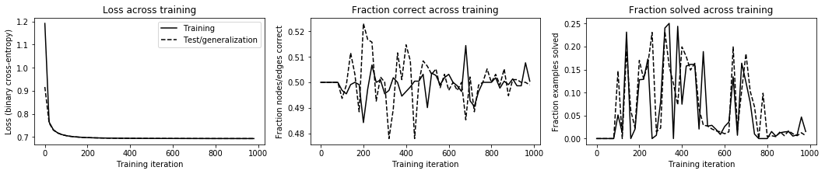
5. KGCN Intermediate Results:
Results with 2 classes [500, 1000] rays, FULL DATA - 794 samples per class, training split 70/30:
50\50 exists\non-exists for all scenarios, lack of stability, loss function stagnates at 0.7, same results as for the reduced sample size

Slide 23
# 00000, T 10.6, Ltr 1.1913, Lge 0.9165, Ctr 0.5000, Str 0.0000, Cge 0.5000, Sge 0.0000
# 00020, T 73.1, Ltr 0.7648, Lge 0.7609, Ctr 0.5000, Str 0.0000, Cge 0.5000, Sge 0.0000
# 00040, T 130.4, Ltr 0.7315, Lge 0.7298, Ctr 0.5000, Str 0.0000, Cge 0.5000, Sge 0.0000
…
# 00220, T 677.9, Ltr 0.6969, Lge 0.6968, Ctr 0.4973, Str 0.1287, Cge 0.5168, Sge 0.1300
# 00240, T 735.8, Ltr 0.6963, Lge 0.6963, Ctr 0.5068, Str 0.1728, Cge 0.5157, Sge 0.1614
# 00260, T 799.4, Ltr 0.6959, Lge 0.6959, Ctr 0.5000, Str 0.0000, Cge 0.4927, Sge 0.2306
# 00280, T 862.0, Ltr 0.6956, Lge 0.6956, Ctr 0.5009, Str 0.0072, Cge 0.5021, Sge 0.0147
# 00300, T 924.0, Ltr 0.6953, Lge 0.6953, Ctr 0.4955, Str 0.0801, Cge 0.5000, Sge 0.0231
# 00320, T 988.8, Ltr 0.6951, Lge 0.6950, Ctr 0.4968, Str 0.2403, Cge 0.4780, Sge 0.2327
…
# 00520, T 1612.0, Ltr 0.6939, Lge 0.6939, Ctr 0.5036, Str 0.0270, Cge 0.5031, Sge 0.0273
# 00540, T 1674.4, Ltr 0.6938, Lge 0.6938, Ctr 0.5027, Str 0.0288, Cge 0.5052, Sge 0.0210
# 00560, T 1735.1, Ltr 0.6938, Lge 0.6938, Ctr 0.4991, Str 0.0198, Cge 0.4979, Sge 0.0168
….
# 00760, T 2351.4, Ltr 0.6935, Lge 0.6935, Ctr 0.5000, Str 0.0000, Cge 0.5000, Sge 0.0000
# 00780, T 2414.8, Ltr 0.6934, Lge 0.6934, Ctr 0.5000, Str 0.0000, Cge 0.5052, Sge 0.0985
# 00800, T 2478.3, Ltr 0.6934, Lge 0.6934, Ctr 0.5000, Str 0.0000, Cge 0.5000, Sge 0.0042
….
# 00920, T 2846.2, Ltr 0.6933, Lge 0.6933, Ctr 0.4986, Str 0.0054, Cge 0.5010, Sge 0.0105
# 00940, T 2910.2, Ltr 0.6933, Lge 0.6933, Ctr 0.4986, Str 0.0081, Cge 0.5000, Sge 0.0063
# 00960, T 2973.9, Ltr 0.6933, Lge 0.6933, Ctr 0.5077, Str 0.0468, Cge 0.5000, Sge 0.0126
# 00980, T 3033.4, Ltr 0.6933, Lge 0.6933, Ctr 0.5005, Str 0.0153, Cge 0.4990, Sge 0.0063
match $scn id V41799720; $ray id V46538792; insert $conv(converged_scenario: $scn, minimum_resolution: $ray) isa convergence, has probability_exists 0.500, has probability_nonexists 0.500, has probability_preexists 0.000;
match $scn id V41799720; $ray id V56512672; insert $conv(converged_scenario: $scn, minimum_resolution: $ray) isa convergence, has probability_exists 0.500, has probability_nonexists 0.500, has probability_preexists 0.000;

Slide 24
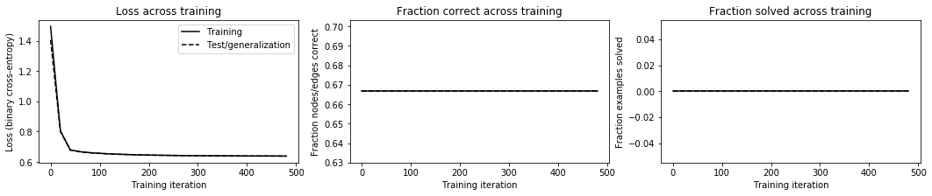
5. KGCN Intermediate Results:
Results with 3 classes [500, 6000, 15000] rays, 80 samples per class, training split 70/30:
0 graphs solved correctly in training and generalisation
ALL RELATIONS ARE PREDICTED TO NOT EXIST
tried different splits, longer trainings -> no results
It seems that learner can only classify semi-correctly between 2 classes at a time.

Slide 25
5. Questions:
How exactly the output graphs are compared to the targets with the labels obfuscated? What differs candidate from non-candidate relations (pre-exist)? Is the loss calculated only based on the label? What are the placeholders target_op, output_ops?
Is it possible to assign weights to negative examples, hence prioritizing the positive one above the others?
What are the exact differences between metrics: Ctr\Str, Cge\Sge?
Can KGCN handle multi-class 1-vs-rest type classification? Isn’t the diagnosis example also such a problem?
5. Can KGCN handle class imbalance or should I keep on working with balanced sets? Max size of balanced set would not exceed 100 samples per class, around 1500 samples total, out of original 9k

Slide 26
5. Questions:
Ideas to discuss:
1. Loss function modification
2. Thresholds for classyfing example as EXISTS
3. Training the classifier in ”steps”? Propose the candidate convergence from the opposite side of the scale, i.e. first train
500 vs 15000, then 500 vs 12500, etc.
then 1000 vs 15000, 1000 vs 12500 and so on.
Can I propagate the results of intermediate trainings to the next step?
Is this approach feasible? It becomes a binary classification problem (ordinal classification).

Slide 27
Github & runtime instructions
https://github.com/Qbbz/SSP
Grakn Core 1.6.2, Python Client 1.6.1
list of required packages in requirements.txt
pip install requirements.txt

Slide 28
Github & runtime instructions
Download the whole folder (dependencies), but for KGCN you will use only:
kgcn_ssp.py
kgcn_data_migrate.py

Slide 29
Github & runtime instructions
There’s always the same schema file:
ssp_schema_kgcn.gql
However I use different keyspace names, each time loading it with a different fraction of the database. That saves time.
Match the global KEYSPACE name with the name that you give to the schema in:
line 46, kgcn_ssp.py
line 29, kgcn_data_migrate.py
Ignore local keyspace variables in kgcn_ssp.py line 528, 533.
Leave them commented out.

Slide 30
Github & runtime instructions
1. To save time you can run pipeline without migrating data to grakn, just load the schema and download folders:
nx_backup_2class (1633 graphs for class 500/1000)
nx_backup_3class (240 graphs for class 500/6000/15000
2. Copy selected folder content to networkx folder!
3. Choose the correct dataset data_sparse2 or data_sparse3 by uncommenting lines (529 and 530) OR (534 and 535). NetworkX graphs will be loaded for these datasets.
Please remember that 2class and 3class differ structurally by the numer of candidate-convergence relations! You can’t use 2class graphs for 3class classification!

